Slide 1
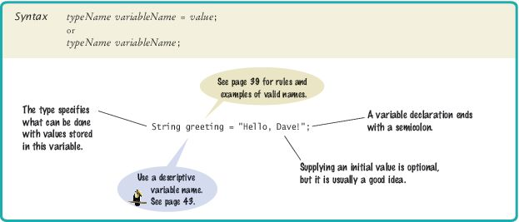

Variables
Use a variable to store a value that you want to use later
To declare a variable named width:
int width = 20;
int height;

Slide 2
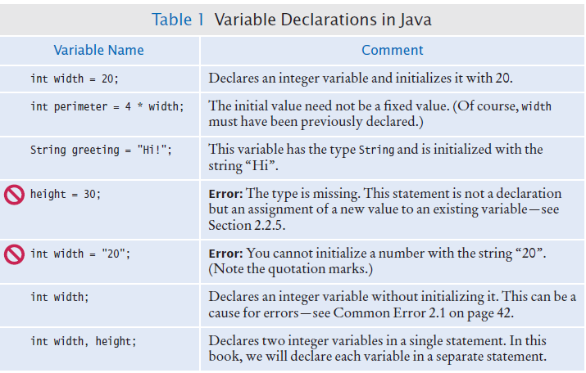
Variable Declarations

Slide 3
Variable Types
Use the int type for numbers that cannot have a fractional part.
int width = 20;
Use the double type for floating point numbers.
double milesPerGallon = 22.5;
Numbers can be combined by arithmetic operators such as +, -, and *
Another type is String
String greeting = "Hello";

Slide 4
Variable Names
Pick a name for a variable that describes its purpose.
Rules for the names of variables, methods, and classes:
Must start with a letter or the underscore (_) character, and the remaining characters must be letters, numbers, or underscores.
Cannot use other symbols such as ? or % or a space
Use uppercase letters to denote word boundaries, as in milesPerGallon. (Called camel case)
Names are case sensitive
You cannot use reserved words for variable names such as double or class

Slide 5
Names
By Java convention:
variable names start with a lowercase letter.
class names start with an uppercase letter.

Slide 6
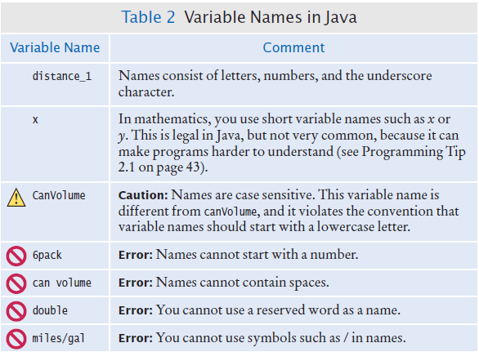
Variable Names in Java

Slide 7
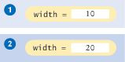
Assignment
Use the assignment operator (=) to change the value of a variable.
You have the following variable declaration
int width = 10;
To change the value of the variable, assign the new value
width = 20;
Figure 2 Assigning a New Value to a Variable

Slide 8
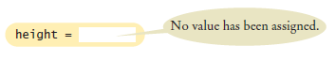
Assignment
It is an error to use a variable that has never had a value assigned to it:
int height;
int width = height; // ERROR - uninitialized variable height
The compiler will complain about an "uninitialized variable"
Figure 3 An Uninitialized Variable

Slide 9
Assignment
The right-hand side of the = symbol can be a mathematical expression:
width = height + 10;
This means
compute the value of height + 10
store that value in the variable width
width = width + 10
The assignment operator = does not denote mathematical equality.

Slide 10
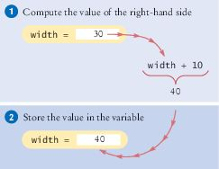
Assignment
Figure 4 Executing the Statement width = width + 10

Slide 11
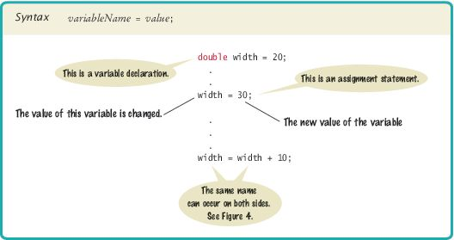
Syntax 2.2 Assignment

Slide 12
Self Check 2.3
What is wrong with the following variable declaration?
int miles per gallon = 39.4
Answer: There are three errors:
You cannot have spaces in variable names.
The variable type should be double because it holds a fractional value.
There is a semicolon missing at the end of the statement.

Slide 13
Self Check 2.4
Declare and initialize two variables, unitPrice and quantity, to contain the unit price of a single item and the number of items purchased. Use any reasonable initial values.
Answer:
double unitPrice = 1.95;
int quantity = 2;

Slide 14
Self Check 2.6
What are the types of the values 0 and "0"?
Answer: int and String

Slide 15
Self Check 2.7
Which number type would you use for storing the area of a circle?
Answer: double

Slide 16
Self Check 2.8
Which of the following are legal identifiers?
Greeting1 g void 101dalmatians Hello, World <greeting>
Answer: Only the first two are legal identifiers.

Slide 17
Self Check 2.10
Is 12 = 12 a valid expression in the Java language?
Answer: No, the left-hand side of the = operator must be a variable.

Slide 18
Self Check 2.11
How do you change the value of the greeting variable to "Hello, Nina!"?
Answer:
greeting = "Hello, Nina!"; Note that String greeting = "Hello, Nina!"; is not the right answer—that statement declares a new variable

